Slide 1

Distribution
- Binomial distribution
- Poisson distribution
- Geometric distribution
- Normal distribution

Slide 2
Binomial distribution
Binomial distribution is a discrete probability distribution which is obtained when the probability P of the happening of an event is same in all the trials, and there are only two events in each trial.
Eg:
The probability of getting a head when a coin is tossed a number of times, must remain same in each toss
i.e. p= 1/2

Slide 3
Characteristics of binomial distribution
It is a discrete distribution which gives the theoretical probabilities.
For each trial there are only two possible outcomes on each trial, success (p) or a failure (r).
Each trial is independent and therefore the probability of success and the probability of failure is the same for each trial.

Slide 4
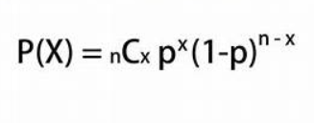
Binomial distribution formula
This formula is often called the general term of the binomial distribution.
If ‘X’ is a discrete random variable with probability mass function.
Where x=0,1,2,3…..n & q= 1-p, then ‘X’

Slide 5
Expected value
The expected value of a binomial distribution equals the probability of success (p) for n trials:
E(X) = np
E(X) also equals the sum of the probabilities in the binomial distribution

Slide 6
Assumptions for binomial distribution
The number of trials ‘n’ is finite.
For each trial, the two outcomes are mutually exclusive.
P(S) =p is constant. P(F) = q = 1- p.
The trials are independent, the outcome of a trial is not affected by the outcome of any other trial.
The probability of success, p, is constant from trial to trial.

Slide 7

Binomial distribution problem
A box of T-Shirts has many different colors in it. There is a 15% chance of getting a pink T-Shirts . What is the probability that exactly 4 T-Shirts in a box are pink out of 10?
We have that:
n = 10, p=0.15, q=0.85, x=4
When we replace in the formula:
Interpretation: The probability that exactly 4 T-Shirts in a box are pink is 0.04.

Slide 8
What is Poisson distribution ?
Poisson distribution is a limiting form of the binomial distribution in which n, the number of trials, becomes very large and p, the probability of success of the event is very very small.
The Poisson distribution is a discrete probability distribution for the counts of events that occur randomly in a given interval of time (or space).
The Poisson distribution is used in those situations where the probability of happening of an event is small i.e. the event rarely occurs.

Slide 9
Characteristics of Poisson distribution
Poisson distribution is a discrete distribution.
It depends mainly on the value of the mean m.
This distribution is positively skewed to the left. With the increase in the value of the mean m, the distribution shift to the right and the skewness diminished.
If n is large & p is small , this distribution gives a close approximation to binomial distribution. Since the arithmetic mean of poisson is same as the binomial.

Slide 10
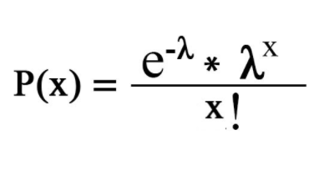
Poisson distribution equation
The probability of observing x events in a given interval is given by,
e is a mathematical constant e = 2.718282

Slide 11
Poisson distribution problem
1) Consider, in an office 2 customers arrived today. Calculate the possibilities for exactly 3 customers to be arrived on tomorrow.
Soln:
Find f(x)
P(X = 3 ) = (0.135)(8)/ 3! = 0.18
Hence there are 18% possibilities for 3 customers to be arrived in tomorrow.

Slide 12
Geometric distribution
A geometric distribution is defined as a discrete probability distribution of a random variable “x” which satisfies some of the conditions. The geometric distribution conditions are. A phenomenon that has a series of trials, Each trial has only two possible outcomes either success or failure, The probability of success is the same for each trial.

Slide 13
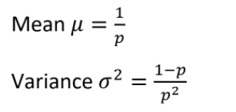
Geometric distribution
The geometric distribution represents the number of identical and independent Bernoulli trials that are done until the first success occurs.
Mean and variance of geometric distribution

Slide 14
4 parts of a Geometric distribution
Each trial have only two possible mutually exclusive outcomes: success or failure
Probability of success is fixed
Trials are independent
No fixed number of trials – try until you suceed

Slide 15
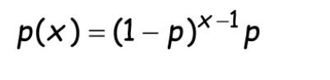
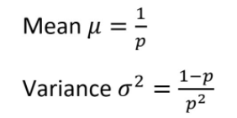
Formula for the geometric distribution
P = probability of sucess
Where x = 1,2,3,..
The mean and variance of the geometric distribution is

Slide 16
Geometric distribution problem
Example:
A fair coin is tossed.
a) What is the probability of getting a tail at the 5th toss?
b) Find the mean μ and standard deviation σ of the distribution?
Solution:
Let "getting a tail" be a "success". For a fair coin, the probability of getting a tail is p=1/2 and
not getting a tail (failure) is 1- p = 1- ½ = ½

Slide 17

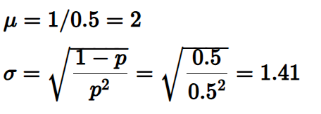
Geometric distribution problem
For the first 4 tosses and a success at the 5th toss implies getting "no tail" (failure) for the first 4 tosses and a success at the 5th toss.
Hence,
b)

Slide 18
Normal distribution
Normal distribution sometimes called the “bell curve". It has the shape of a bell.
A symmetrical probability distribution where most results are located in the middle and few are spread on both sides
Normal distribution are symmetric around their mean.
The area under the normal curve is equal to 1.0.
Normal distributions are defined by two parameters, the mean and the standard deviation

Slide 19
Normal distribution
Many things closely follow a normal distribution:
Heights and weights of adults
Size of things produced by machines
Marks on a test
Errors in measurements
Blood pressure
Quality control test results.
Everyday data sets follow approximately the normal distribution.

Slide 20
Normal distribution
Used to illustrate the shape and variability of the data.
Used to estimate future process performance.
Normality is an important assumption when conducting statistical analysis.

Slide 21
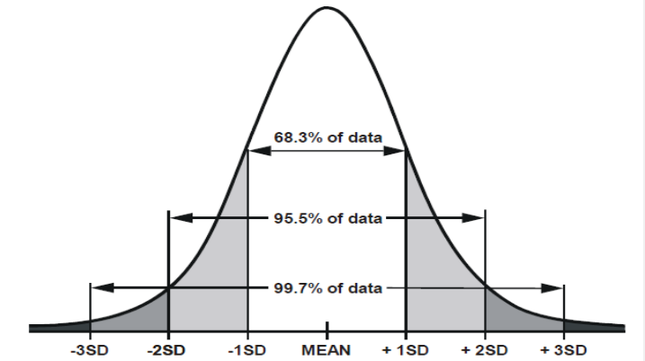
Normal distribution
Empirical rule:
For any normally distributed data:
68% of the data fall within 1 standard deviation of the mean.
95% of the data fall within 2 standard deviation of the mean.
99.7% of the data fall within 3 standard deviation of the mean.

Slide 22
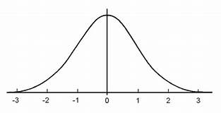
Normal distribution
Standard normal distribution:
To convert any normal distribution to the standardized form and then use the standard normal table to find probabilities.
The standard normal distribution (z distribution) is a way of standardizing the normal distribution.
It always has a mean of 0 and a standard deviation of 1.

Slide 23
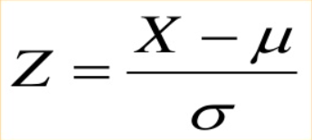
Standard normal distribution formula
Where x represents an element of the data set, the mean is represented by µ and standard deviation by σ
Will convert a normal table into a standard normal table.

Slide 24

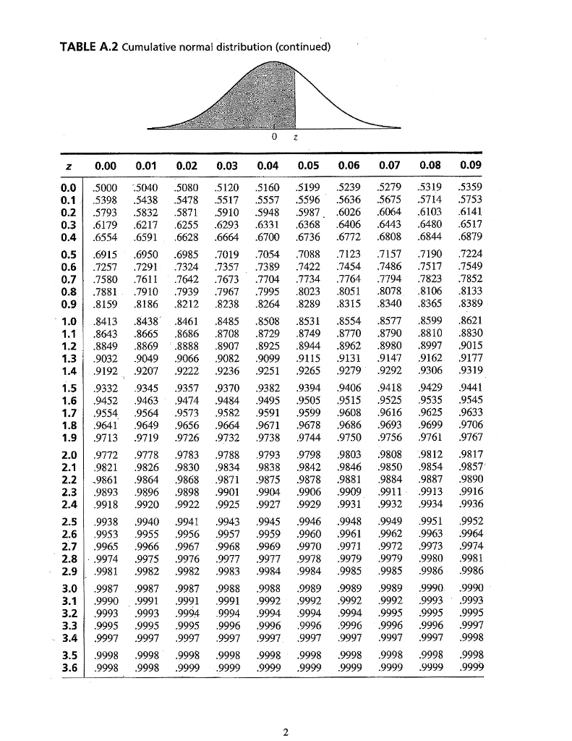
Standard normal table

Slide 25
Normal distribution problem
1) X is a normally distributed variable with mean μ = 30 and standard deviation σ = 4. Find
a) P(x < 40)
b) P(x > 21)
c) P(30 < x < 35)
Soln:
For x = 40, the z-value z = (40 - 30) / 4 = 2.5
Hence P(x < 40) = P(z < 2.5) = [area to the left of 2.5] = 0.9938

Slide 26
b) For x = 21, z = (21 - 30) / 4 = -2.25
Hence P(x > 21) = P(z > -2.25) = [total area] - [area to the left of -2.25]
= 1 - 0.0122 = 0.9878
c) For x = 30 , z = (30 - 30) / 4 = 0 and for x = 35, z = (35 - 30) / 4 = 1.25
Hence P(30 < x < 35) = P(0 < z < 1.25) = [area to the left of z = 1.25] - [area to the left of 0]
= 0.8944 - 0.5 = 0.3944

